Slide 1
Analysis of Kroger Shopping Behavior
Josh Allen
Sierra Funte
Kevin Gardner
Digvijay Sawant

Slide 2
Executive Summary
Coupon campaigns need to target
Age 45-54
Income $50-74K
Customer engagement decreases the most in
Grocery
Drug GM

Slide 3
Customer Spending Trends

Slide 4
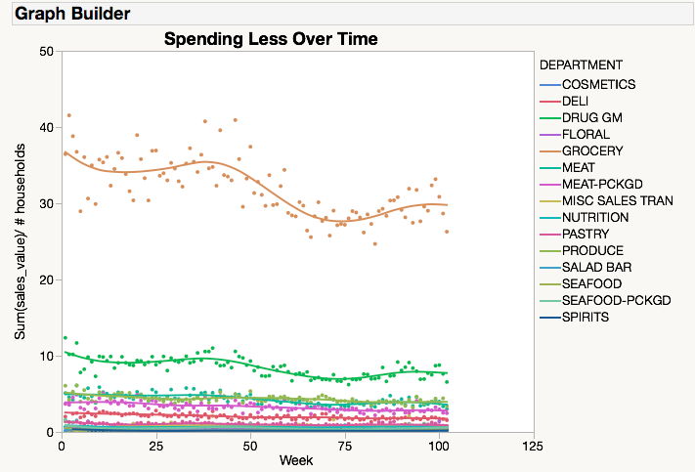
Customers who spent less
Grocery down $8/ week
Drug GM down $3/ week
Grocery
Drug GM
Notes:
This chart includes households who spent less per week with us in year two than year one
Sales are separated by department to show which categories they became less engaged with
We see decline in sales for each of the top 15 departments
But the largest dollar amounts are in Grocery and Drug GM
We estimate Grocery has gone down about $8/ week and Drug GM has gone down about $3/ week

Slide 5
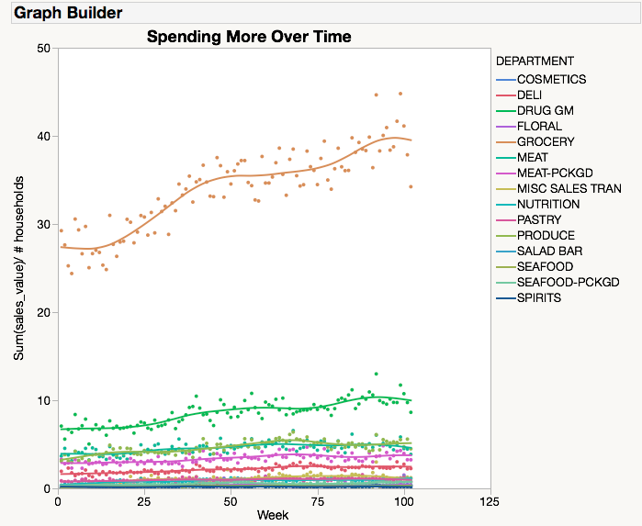
Customers who spent more
Grocery up $14/ week
Drug GM up $5/ week
Grocery
Drug GM
Notes:
This chart includes households who spent more per week with us in year two than year one
Sales are separated by department to show which categories they became more engaged with
We see increase in sales for each of the top 15 departments
But the largest dollar amounts are in Grocery and Drug GM
We estimate Grocery has gone down about $14/ week and Drug GM has gone up about $5/ week

Slide 6
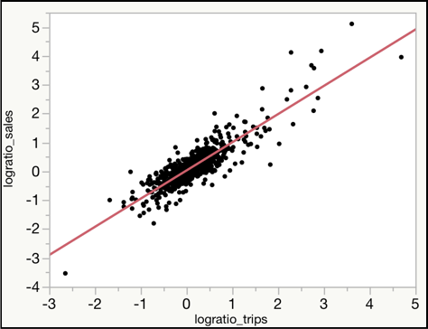
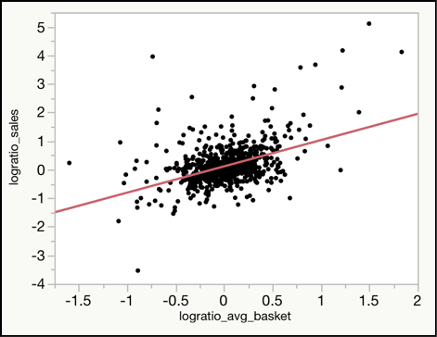
Influence of Trips vs Basket Size
Trips have more influence on changes in sales/week
Change in Sales Vs Change in Trips per Week
Change in Sales Vs Change in $ per Basket
Notes:
Here we look at weather changes in # of trips or changes in $/ basket explain more of the variation in sales
Here we’ve shown using log ratios of two years for each variable but using differences gives a similar result
We see that changes in # trips/ week seem to have larger impact than average $/ basket
And now Diggy (or Josh) is going to talk about how we might optimize coupons given what we’ve found

Slide 7
Coupons

Slide 8
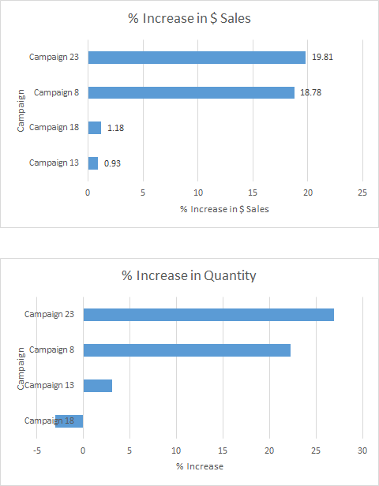
Coupon Campaign Effectiveness
Type A, Type B and Type C
Campaigns 23(B) and 8(A) had the highest percent increases in product sales and quantity sold

Slide 9
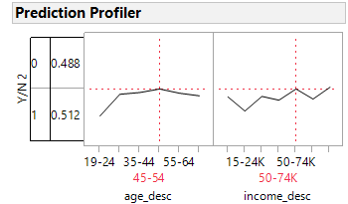
Coupon Usage
Who’s redeeming a coupon?
Income level: $50,000 – 74,000
Age: 45 - 54
Notes:
Who’s using them?
Demographics: age, income level, household size, gender, married, homeowner,
We found that the only demographic that was significant was the income level and age
Then conducted a profiler to further analyze these groups and found that age 45-54 and income level 50-74K

Slide 10
Recommendations

Slide 11
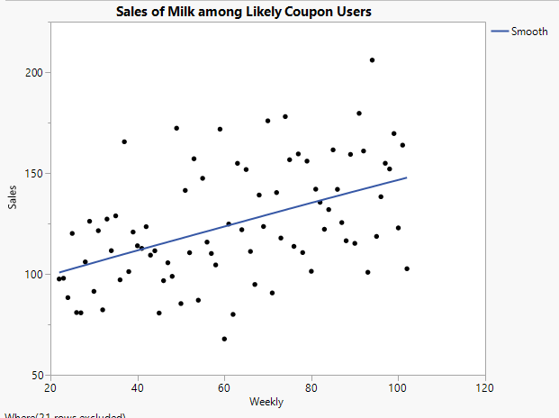
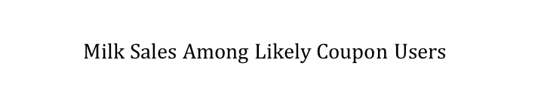
Recommendations
Highest Category
Beef: $180/week
Soft Drinks: $167/week
Milk: $124/week
Cheese: $118/week
Growth Potential
$$Milk Sales Among Likely Coupon Users$$
Milk sales increasing for likely coupon users

Slide 12
Questions?
Notes:
Can mention the report if asked for anything we don’t have outputs for.

